Slide 1
Empowering Cyber Security:
Building Communities for Threat Intel Sharing
Amanda Ross
IT Security Analyst

Slide 3
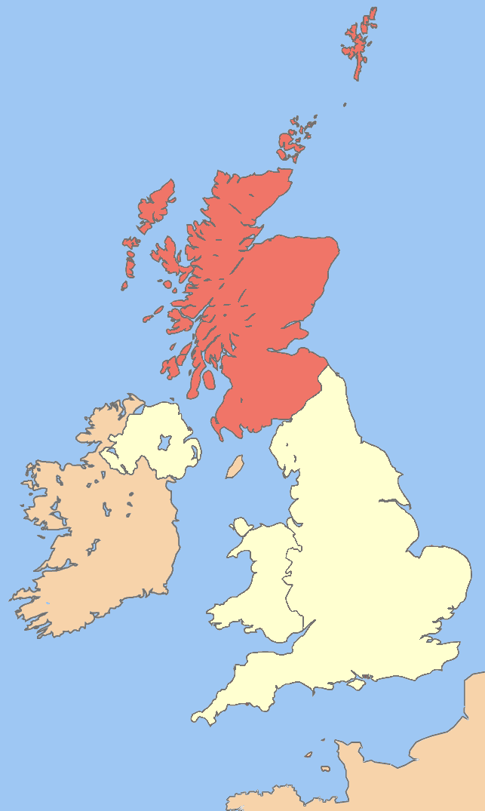
Context and Objectives
Two-year initiative at the University of St Andrews
Aim: Creation of threat intel sharing communities
Goal: Comprehensive Cyber Threat Intelligence coverage for Scotland
Why Scotland? Small and Medium Enterprises dominate, need for:
Digestible intel
Quick dissemination
Standardisation
Cross-sector coverage

Slide 4
Statistics
2 Communities (1 MISP instance each)
20+ organisations
Over 400,000 events
Over 3 million attributes
Over 12,000 correlations
Over 650 Critical or High CVEs

Slide 5
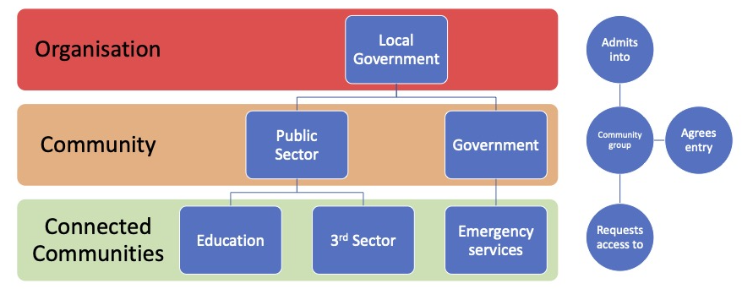
The Model - Sharing with Purpose
Utilising the FIRST Traffic Light Protocol (TLP) for sharing
Mapping sharing groups to TLP levels for clarity
Red: Restricted
Amber: Limited
Green: Community
Clear: Public

Slide 6
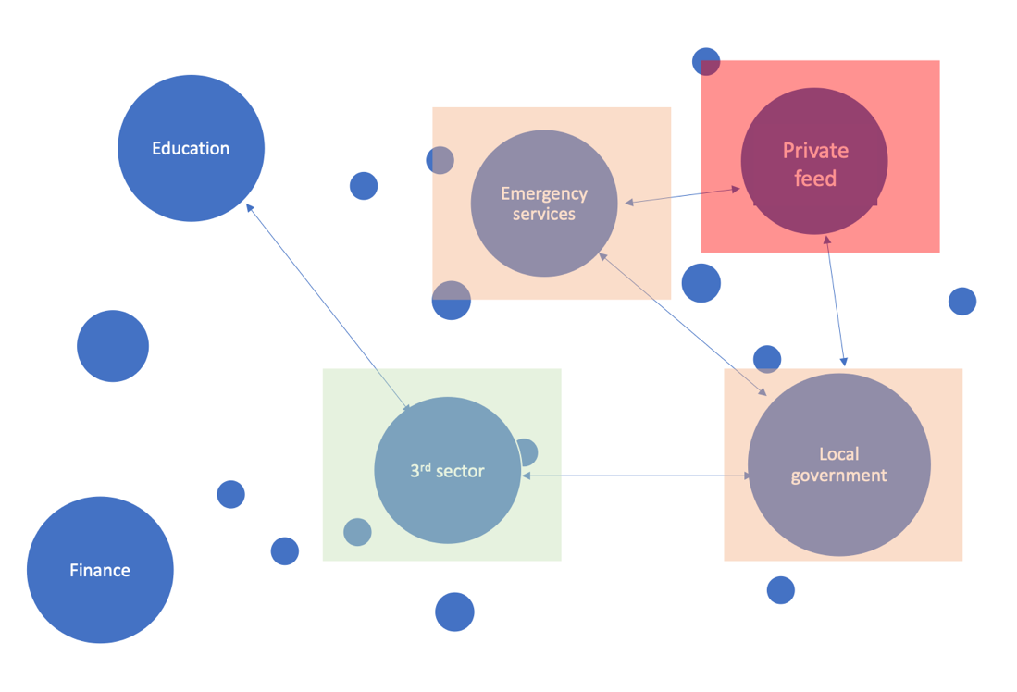
Envisioned Platform State
A network of communities
Emergency services
Local government
Third sector
Inclusive approach
Efficiency and Standardisation
Respecting Confidentiality

Slide 7
Governance Structure
Steering committees for each sharing community
Responsibilities:
Membership oversight
Partner approvals
Third-party access management
Feed enablement decisions

Slide 8
Data Standards and Sharing Agreements
Introduction of data standards document late in the project
Covered:
Event Tags
Data objects
Correlation guidance
Distribution rules
Sharing agreements embedded within
design outlines

Slide 9
Lessons Learned
The Platform: Choosing MISP for simplicity
Governance: Provide guidelines without stifling progress
Standards: Helpful but adaptable
Actionability: Sharing is easy, utilising intel requires support

Slide 10
Advancing Together: Cybersecurity Journey Continues
Key Takeaways:
Collaboration strengthens defences.
Governance and flexibility are essential.
Standards guide, adaptability drives progress.
Support empowers action.
Our Vision:
Interconnected communities fortifying cybersecurity.
Unified response against cyber threats. Next Steps:
Enhance security and governance.
Foster ongoing collaboration.
Continually refine our approach.

Slide 11
Any Questions?
Amanda Ross
aer20@st-andrews.ac.uk
linkedin.com/in/amanda-ross81/

