Slide 1



Tuesday, May 14th
Copenhaguen

Slide 2


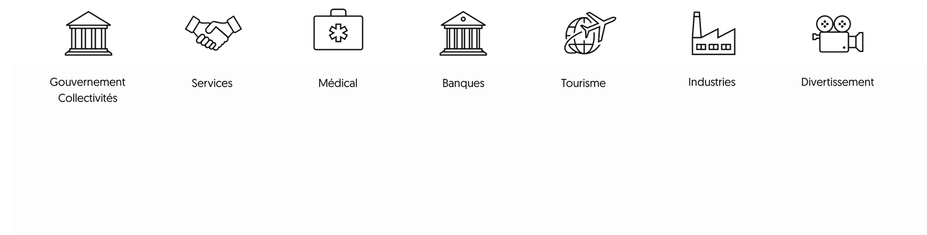







W h o a r e w e ?
Our key numbers
Industry coverage
30
More than employees
350
Government
Collectivities
Services
Medical
A group of over people
10
More than years of existence within the group
Monaco Digital
150
Banks
Entertainment
Industries
More than customers
Monaco
Europe
A presence in and in
6
Tourism
Customers in over countries
T R U S T - I N N O V A T I O N - E X C E L L E N C E
Protect.Audit.Detect.React.

Slide 3
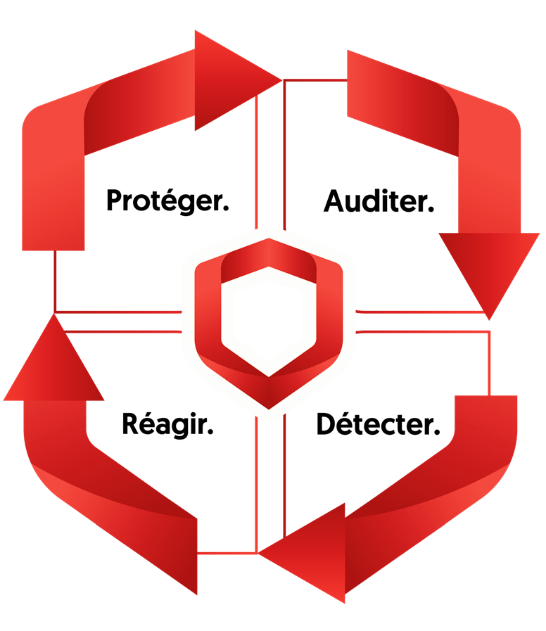
O u r s t r a t e g y
Protect
Audit
React
Detect
T R U S T - I N N O V A T I O N - E X C E L L E N C E
Protect.Audit.Detect.React.

Slide 4




C E R T - M C S
Prepare
Incident response / crisis management
Incident management and cyber crisis preparation
  Crisis management plan
  Governance
  Documentation
  Awareness / Formation
  Training
  Investigation
  Remediation
  Management
  Post-incident information
  Legal support
Anticipate
Co-piloting the reconstruction
Cyber Threat Intelligence (CTI)
  Knowledge of your targeted threats
  Sectoral
  External fraud
  Knowledge and imminent alert bulletins
  Cyber due diligence
  Active Directory external reconstruction
  Restoring the information system to normality
  Contingency backup
T R U S T - I N N O V A T I O N - E X C E L L E N C E
Protect.Audit.Detect.React.

