Slide 1
Network Security Monitoring at 100Gbps
Kashif Mohammad
University of Oxford
Information Security Operations Team(OxCERT)
Notes:
Good afternoon Everyone, My name is Kashif Mohammad and I am head of Information Security operations Team at the University of Oxford. This is the first time, I am attending a Trusted Introducer Event so I will take this opportunity to give a brief overview of University of Oxford InfoSec Team and why Oxford University is a unique institution in term of managing cyber security
Then I will go topic of this presentation is Network Security Monitoring at 100Gbps.

Slide 2
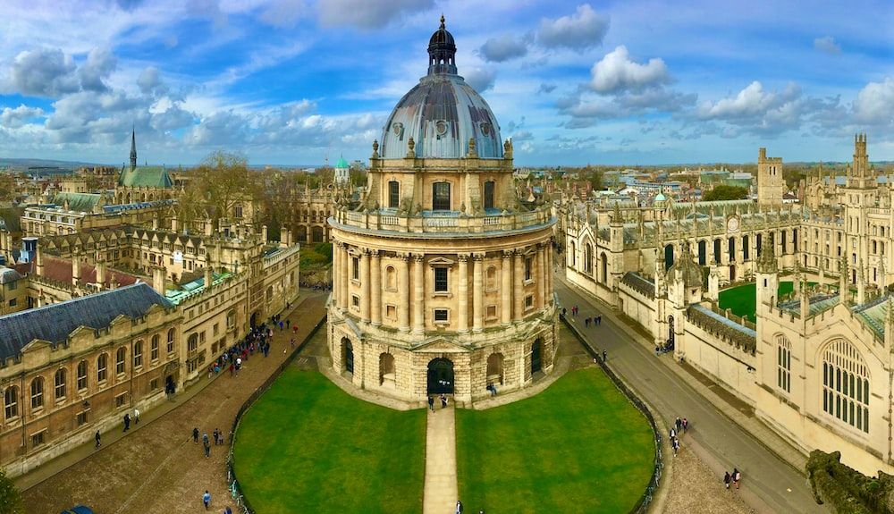

Slide 4
Information Security Team
Infosec Team
CISO
OxCERT(8)
GRC(6)
50K Users
120 SubEstates
150K Devices
110 Departments and Centers
320 Email Domains
38 Colleges

Slide 5
Network Monitoring at 100Gbps
Requirements
Challenges
Detection of malicious activities on the network
Pattern of abusive behavior over time
Regulatory requirements
Passive Monitoring
Cost
Scalability
Resilience
Integration with the existing tools
Data ingest and storage
Extreme optimization

Slide 6
Market Research

Slide 7
Setup Design
100Gbps Tx
Internet
University Backbone
100Gbps Rx
TAP
Packet Broker
200Gbps full duplex LAG
200Gbps full duplex LAG
200Gbps
FPGA Card
25Gbps
NIC
Net Flow
IDS

Slide 8
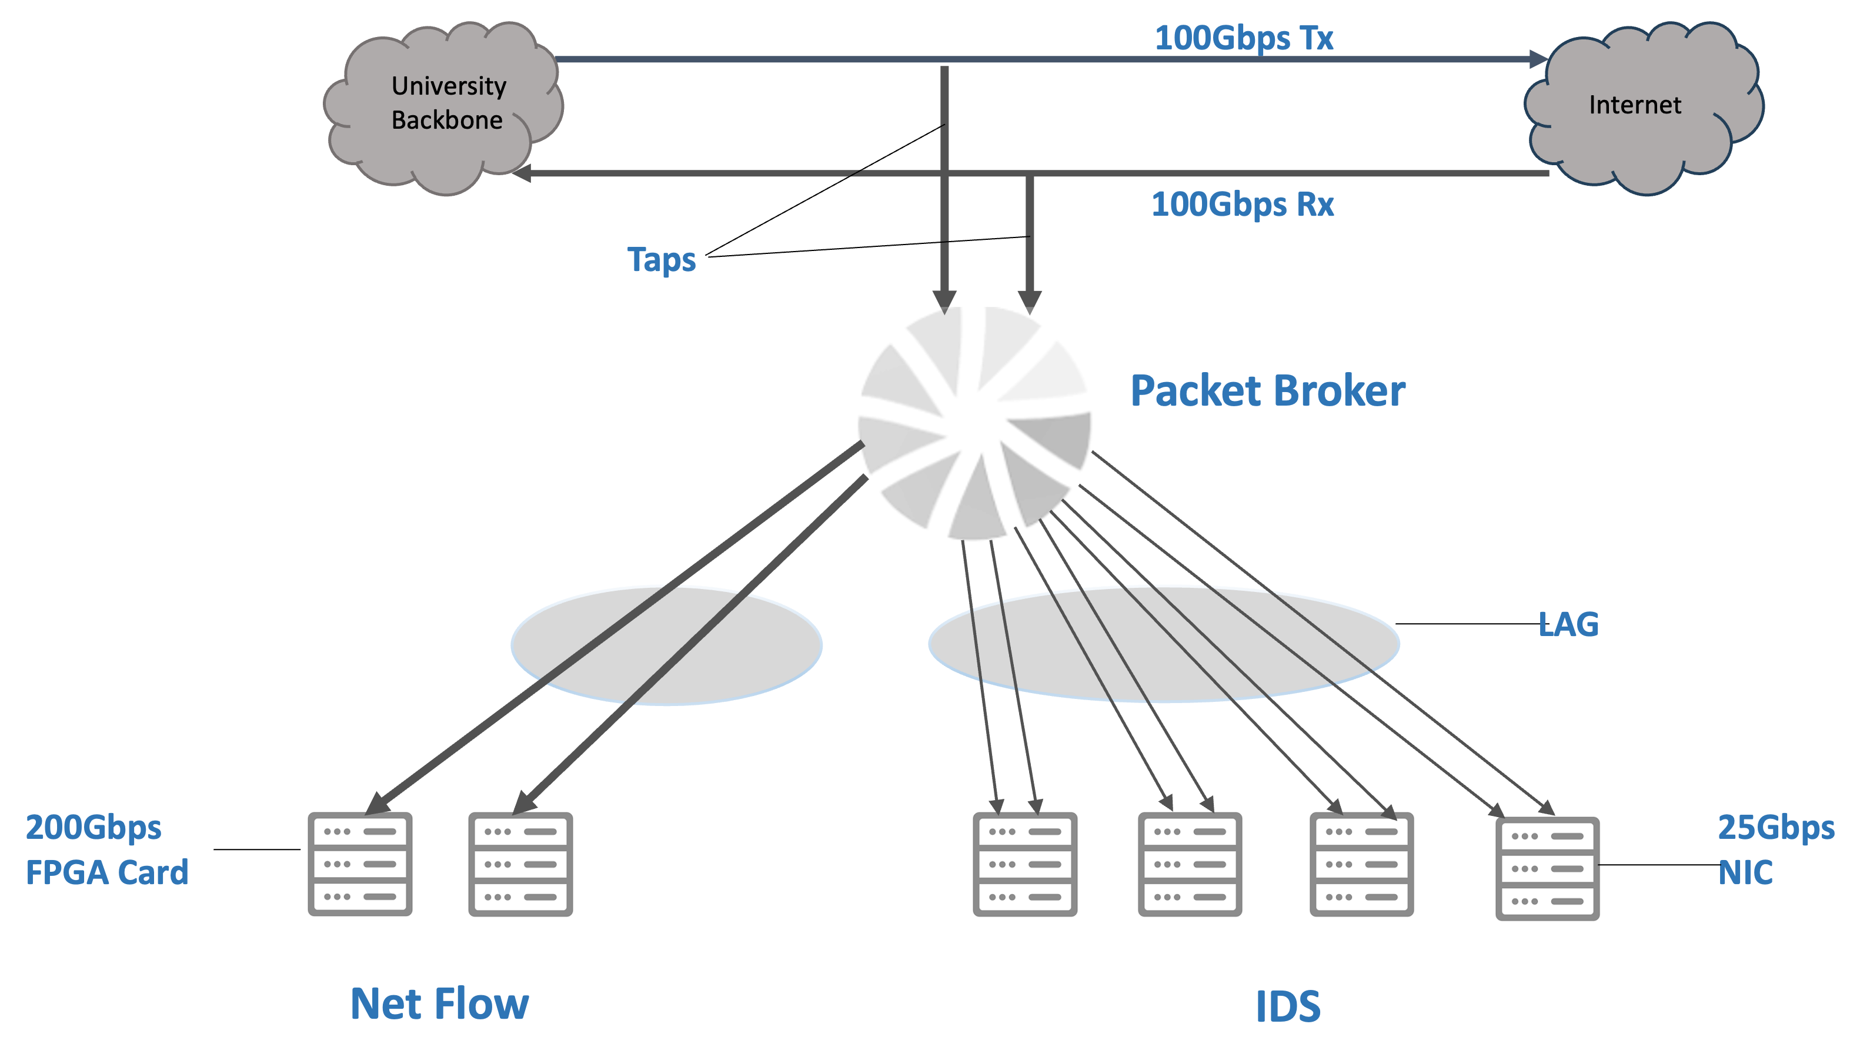
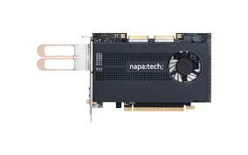
Traffic Capture for Netflow Genaration
Napatech NT200A02 FPGA Card
/opt/napatech3/bin/ntpl -e "Delete = All"
/opt/napatech3/bin/ntpl -e "HashMode = Hash2TupleSorted"
/opt/napatech3/bin/ntpl -e "Assign[StreamId=(0..15)] = All"

Slide 9
Netflow Generation
FPGA Card
PF_RING ZC
Cento
Kafka Topic
Special thanks to Ntop for providing free academic licenses for PF_RING ZC and Cento

Slide 10
Intrusion Detection System
Using 22000 out of 60000 (Aprox) rules provided by the ETpro
enabled_group:
malware:
- trojan-activity
- successful-user
- successful-admin
- command-and-control
- attempted-admin
exploit:
- successful-admin
- command-and-control
- web-application-attack
- web-application-activity
- suspicious-login
- attempted-admin
trojan:
- trojan-activity
- successful-admin
worm:
- trojan-activity
current_events:
- trojan-activity
hunting:
- misc-activity
enabled_sid:
- '2027472'
- '2046188’
- ……
disabled_sid:
- '2029992'

Slide 11
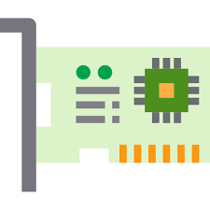
System Performance Optimization
Packet Steering
NUMA Node and CPU affinity
Receive Side Scaling(RSS)
Intel XV710 25 Gb NIC
25Gbps Full duplex

Slide 12
NIC Optimization
usr/bin/ip link set enp59s0f1 promisc on arp off up
usr/bin/ip link set enp59s0f1 mtu 9000
usr/sbin/ethtool -L enp59s0f1 combined 32
usr/sbin/ethtool -K enp59s0f1 rx off
usr/sbin/ethtool -K enp59s0f1 tx off
usr/sbin/ethtool -K enp59s0f1 tso off
usr/sbin/ethtool -K enp59s0f1 gso off
usr/sbin/ethtool -K enp59s0f1 gro off
usr/sbin/ethtool -K enp59s0f1 rxhash on
usr/sbin/ethtool -K enp59s0f1 ntuple on
usr/sbin/ethtool -K enp59s0f1 sg off
usr/sbin/ethtool -K enp59s0f1 txvlan off
usr/sbin/ethtool -K enp59s0f1 rxvlan off
usr/sbin/ethtool -X enp59s0f1 hkey 6D:5A:6D:5A:6D:5A:6D:5A:6D:5A:6D:5A:6D:5A:6D:5A:6D:5A:6D:5A:6D:5A:6D:5A:6D:5A:6D:5A:6D:5A:6D:5A:6D:5A:6D:5A:6D:5A:6D:5A:6D:5A:6D:5A:6D:5A:6D:5A:6D:5A:6D:5A equal 32
usr/sbin/ethtool -N enp59s0f1 rx-flow-hash tcp4 sd
usr/sbin/ethtool -N enp59s0f1 rx-flow-hash tcp6 sd
usr/sbin/ethtool -N enp59s0f1 rx-flow-hash udp4 sd
usr/sbin/ethtool -N enp59s0f1 rx-flow-hash udp6 sd
usr/local/bin/set_irq_affinity 2,4,6,8,10,12,14,16,18,20,22,24,26,28,30,34,36,38,40,42,44,46,48,50,52,54,56,58,60,62 enp59s0f1
Most of these optimizations are based on Peter Manav’s Suricata Extreme Performance guide https://github.com/pevma/SEPTun-Mark-II

Slide 13
ElasticSearch
Logstash
Logstash
Elasticsearch
I Kibana
IDS Alerts
K
Forwarder Nodes
(2 locations)
Queue Servers
(2 locations)
Processing Nodes
(2 locations)
Master Nodes
(3 locations)
Load Balancer
(1 locations)
Data Nodes Hot
(2 locations)
Kibana Nodes
(2 locations)
NTOP Cento
Data Collection
Forwarder & Triage
Queue
Processing & Enrichment
Indexing & storing
Visualization & Analysis

Slide 14
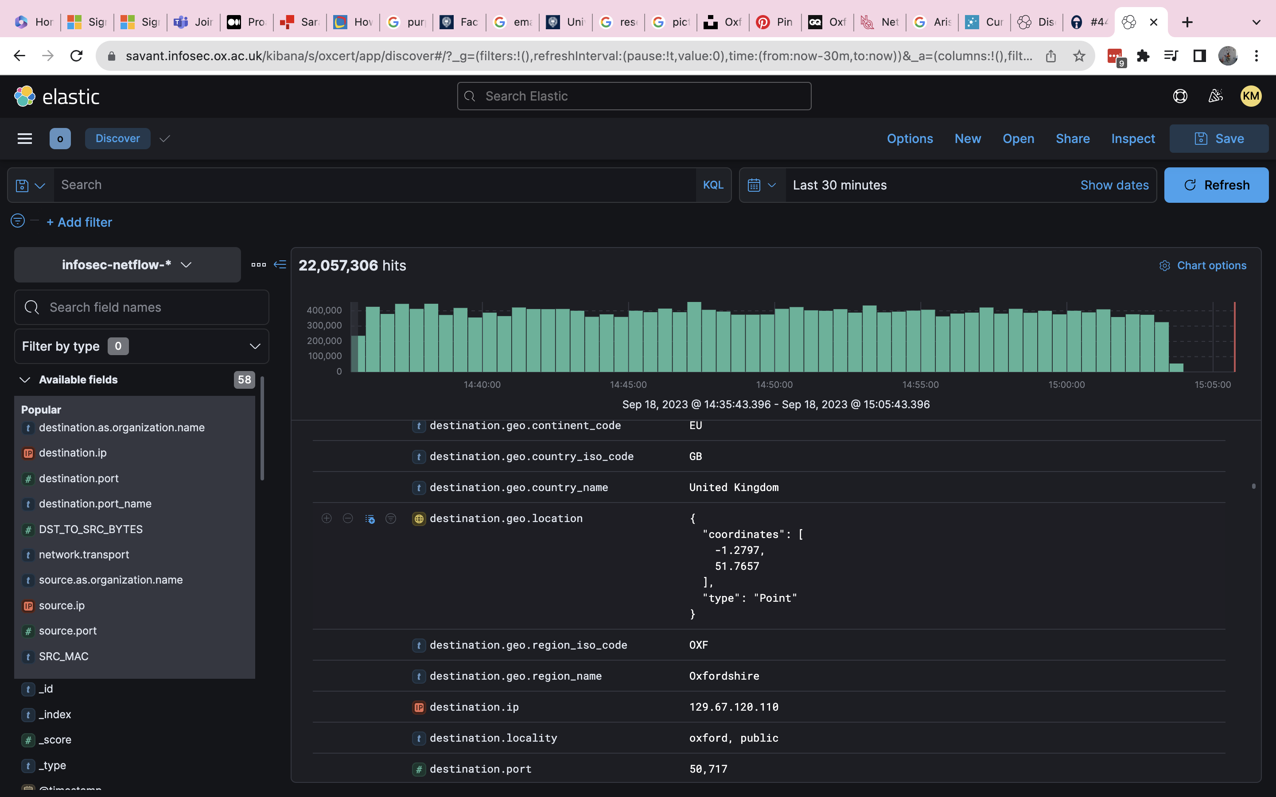
4 Billion events/day
800GB of data/day

Slide 15
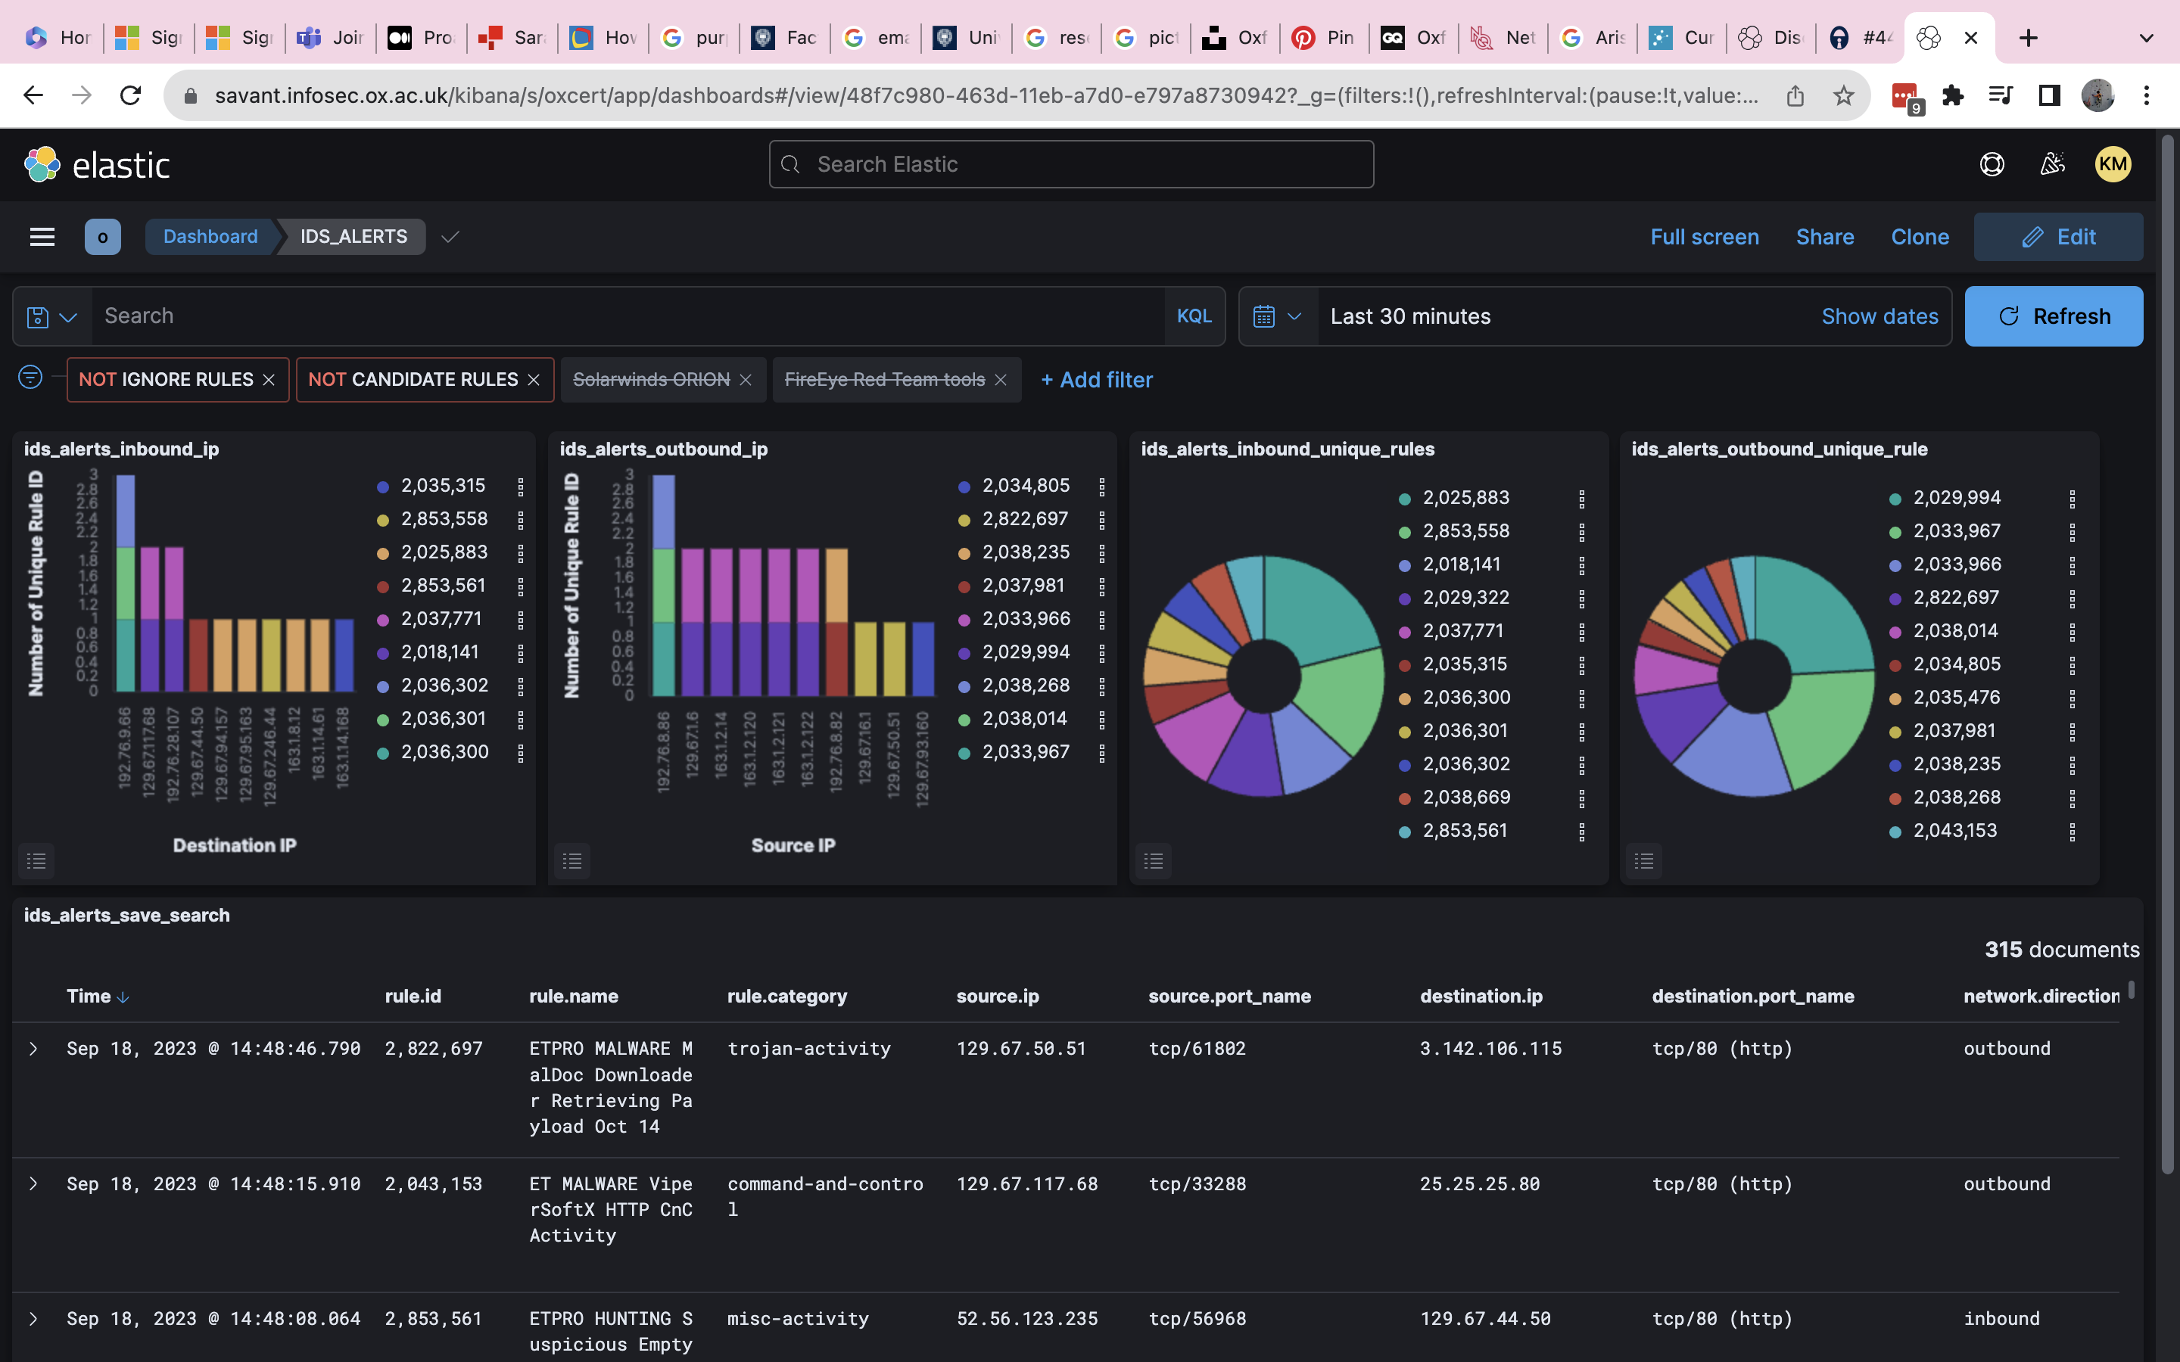
IDS Dashboard

Slide 16
Thank You
Questions?

