Slide 1
STATE OF CYBERSECURITY IN CENTRAL ASIA
Talgat Nurlybayev
Kazakhstan Research and Education Network Association (KazRENA) talgat@kazrena.kz​

Slide 2
AGENDA
Introduction​
Current Situation
​Risks and Challenges
Perspectives
​Summary

Slide 3
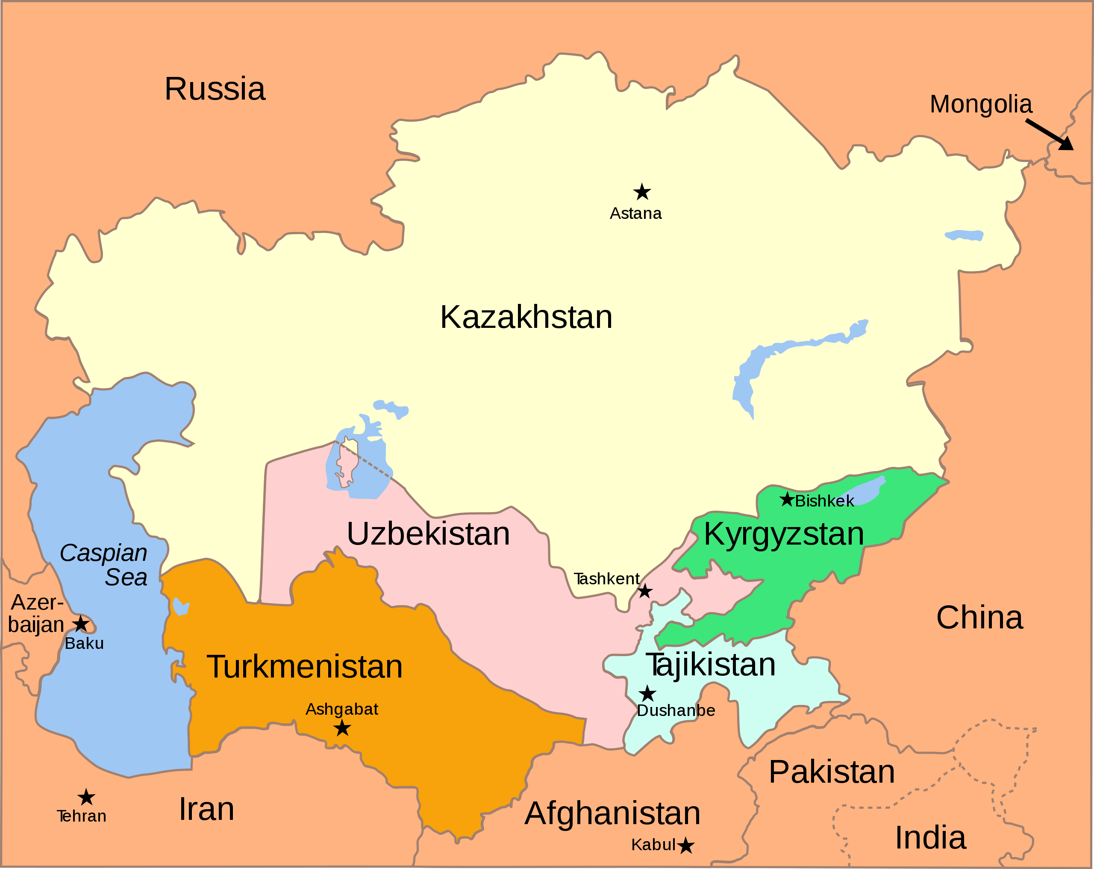
Introduction
Central Asia is the region with territory more than 4 mln. sq.km and fast-growing population about 80 million people. The region consists of 5 countries: Kazakhstan, Kyrgyzstan, Tajikistan, Turkmenistan and Uzbekistan.
The countries of Central Asia share more than just geography; they also share a similar legacy as a part of Soviet Union. They all have close political and economical relationship with Russia.

Slide 4
Introduction
Countries in the Central Asia are increasingly investing in information and communication technologies (ICTs).
Social infrastructure, the financial sector, government services, schools, and hospitals in the region are now irreversibly dependent on interconnectivity and the Internet.

Slide 5
At the same time, the role of ICTs has become an integral part of the future of domestic and international security architecture in the Central Asia, emphasizing the need for the development of effective cybersecurity at a regional level.
The majority of global military powers have developed cyberwarfare capabilities and doctrines, and this will inevitably result in more states acquiring this capability in the near future. Non-state actors have also become highly proficient in exploiting cyber vulnerabilities.

Slide 6
Current Situation
Kazakhstan
Kazakhstan has made significant strides in improving its cybersecurity infrastructure in recent years.
The government has introduced several regulations and initiatives to enhance cybersecurity, including the adoption of the National Information Security Doctrine.
Collaboration between government agencies, the private sector, and academia has improved information sharing and threat intelligence.
Despite these efforts, there are still challenges related to the protection of critical infrastructure and a need for further capacity building in the cybersecurity workforce.

Slide 7
Kyrgyzstan
Kyrgyzstan has made progress in developing its cybersecurity capabilities but faces challenges due to limited resources.
The government has taken steps to establish a legal framework for cybersecurity, including the adoption of the Cybersecurity Law.
Capacity building and awareness campaigns are ongoing, but more investments are required to bolster the nation's cybersecurity infrastructure.

Slide 8
Tajikistan
Tajikistan has been working on improving its cybersecurity posture, primarily through international collaboration and assistance.
The government has partnered with international organizations to develop national cybersecurity strategies.
Enhancing digital literacy and education remains a priority to address vulnerabilities in cyberspace.

Slide 9
Turkmenistan
Turkmenistan is in the early stages of developing its cybersecurity capabilities.
The government has shown interest in cybersecurity and is gradually working on building a legal framework.
The lack of a well-defined strategy and a shortage of cybersecurity professionals are challenges that need attention.

Slide 10
Uzbekistan
Uzbekistan has been proactive in enhancing its cybersecurity landscape.
The government has established the "Uzbekistan Cyber Shield" program, focusing on capacity building and cybersecurity awareness.
Partnerships with international organizations have facilitated knowledge sharing and technical assistance.

Slide 11
Current Situation
Central Asia is also being incorporated into the broader cyberspace in which its two main neighbors – Russia and China – are particularly known for their cyber-criminality. A lot of cyberattacks to the region came from the Russian-speaking world.
Russia is considered an international digital crime superpower, especially in terms of online fraud, spam e-mail, and distributed denial of service (DDOS)attacks, which prevent users from accessing systems without harming those systems directly affected. The groups involved in these activities are increasingly controlled by Russian government.

Slide 12
Now, let's discuss the cybersecurity risks associated with the ongoing Russian invasion of Ukraine, which have direct implications for Central Asia:
Popularity of Russian Software Products:
Central Asian businesses and organizations have historically relied on popular Russian software products, such as the 1C accounting program. These products could be vulnerable to cybersecurity threats and espionage, given their Russian origin.
Use of Russian Social Networks:
Russian social networks like VKontakte (VK) and Odnoklassniki are widely used in Central Asia. They may pose risks due to data privacy concerns, potential surveillance, and the spread of disinformation.

Slide 13
Dependence on Russian Internet Services:
Services like Yandex and Mail.ru have a significant user base in Central Asia. Relying on these services can expose the region to potential cyber threats, including data breaches and espionage.
Internet Traffic Routing via Russia:
Almost all internet traffic from Central Asia to the global internet runs through Russian networks. This reliance on Russian infrastructure can be exploited for surveillance and cyberattacks.

Slide 14
To address these risks, Central Asian countries should consider several measures:
Close Cooperation in Cybersecurity with Western Countries:
Central Asian nations should establish strong partnerships with Western countries and international organizations to enhance their cybersecurity capabilities. This collaboration can involve information sharing, joint exercises, and technical assistance.
Improving Regional Cooperation:
Strengthening regional cooperation among Central Asian countries is vital. Establishing a unified approach to cybersecurity can help in sharing threat intelligence, coordinating responses, and developing joint cybersecurity policies and standards.

Slide 15
Investing in Cybersecurity Education:
Central Asian governments should prioritize cybersecurity education and awareness programs. This includes training a skilled workforce, fostering a cybersecurity culture, and educating citizens about online safety to reduce the risk of falling victim to cyber threats.
Diversifying Internet Infrastructure:
Efforts should be made to diversify internet infrastructure by reducing reliance on Russian networks. Developing alternative routes for internet traffic can help mitigate risks associated with centralized control.

Slide 16
CONCLUSION
Central Asia faces significant cybersecurity risks, particularly in light of the ongoing situation in Ukraine and its reliance on Russian technology and infrastructure.
However, with proactive measures such as international cooperation, regional collaboration, cybersecurity education, and diversification of internet infrastructure, Central Asian countries can enhance their cybersecurity posture and better protect their digital environments.

