Slide 1
Managing cyber-attacks and incidents Corporate digital responsibility of public and private organizations
Andrea Fried, Biträdande Professor (CODIRES project leader)
Svjetlana Pantic Dragisic, Dr., Universitetslektor
Subhomoy Bandyopadhyay, Doktorand
5 min Pitch for collaboration lightning talk 70th TF-CSIRT Meeting
Stockholm, 26 September 2023

Slide 2
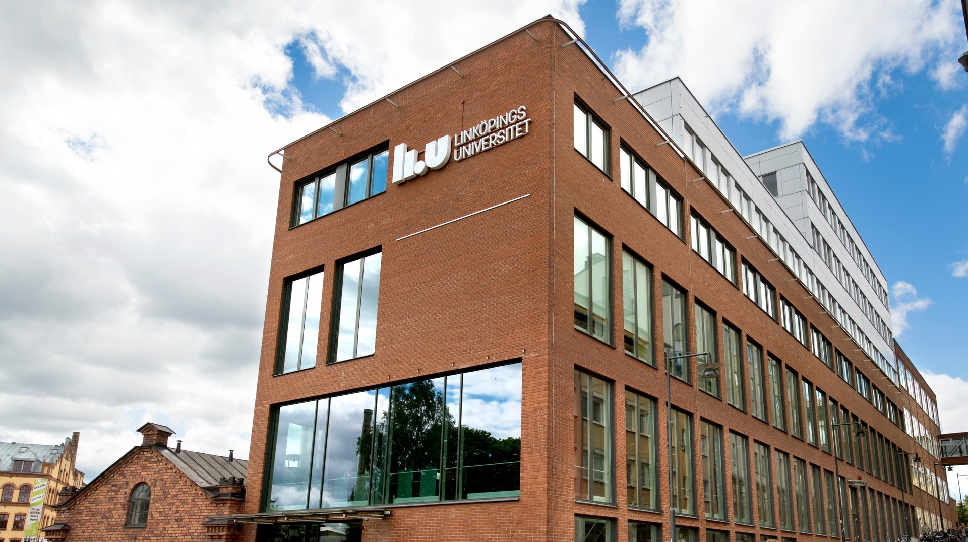
About CODIRES
Funded by the Swedish Research Council (Vetenskapsrådet)
Project no. 2021-06313
Between 2023 and 2025
CODIRES is based at:
Linköping University
Department of Management and Engineering
https://liu.se/en/research/managing-cyber-attacks

Slide 3
Managing cyber-attacks and incidents =
Learning from cyber-attacks and incidents
👉🏻 Corporate Digital Responsibility
💡
Source: TF-CSIRT TRANSITS I materials

Slide 4
About CODIRES
CODIRES gathers new knowledge about how organizations effectively manage and prevent cyber attacks and incidents.
CODIRES’ questions: how do companies deal with cyber incidents and attacks and how employees' roles, obligations, rights and responsibilities are developed to before, during and after ongoing attacks and incidents.

Slide 5
We are interested in learning from (good) practice:
💡
the organizations’ shared values regarding corporate digital responsibility,
the resources organizations invest in cyber and information security,
the professional roles and competencies in organizations affected by and dealing with cyber and information security,
the internal incentive systems to ensure cyber and information security.

Slide 6
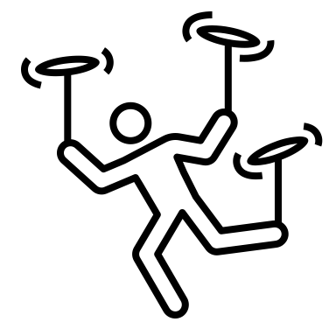
CODIRES aims to identify
different types of how cyber and information security is constructed and organized.
a process model of how organizations deal with cyber-attacks effectively.
the enablers of proactive digital behaviour for effective prevention.

Slide 7
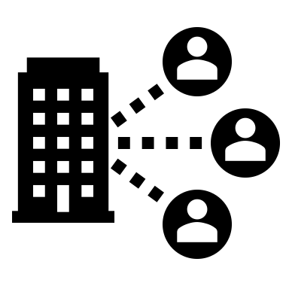
Collaboration ?
Ongoing collaborations
CODIRES wishes to learn about and further participate in activities of CSIRTs.
CODIRES can be a resource for your TF-CSIRT,
too !
Interviews, observations, analysis of documents or similar
Companies connected to:
Norrköping Science Park
Linköping Science Park
Linköping University
Certified teams
Accredited teams
Other CSIRT teams
Private and public organizations
For comparative studies
We feed back the results to our partners in written and oral format.

Slide 8
Get in touch with CODIRES at the TF-CSIRT meeting or :
andrea.fried@liu.se
Pitch for collaboration lightning talk 70th TF-CSIRT Meeting
Stockholm, 26 September 2023
Notes:
The Organisational Dimension of Cybersecurity

