Slide 1
OpenCTI.io - Open Cyber Threat Intelligence
26-09-2023 | 70th TF-CSIRT | Stockholm
Josef.Šmidrkal@revonet.cz
TLP:CLEAR | Public

Slide 2
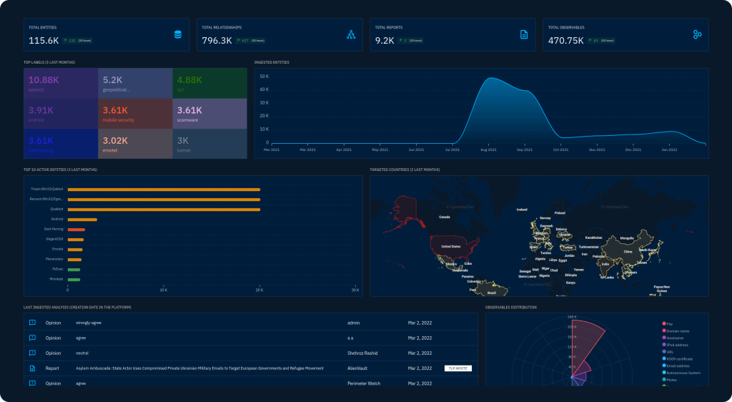
What?
Open Threat Intelligence Platform
Store, organize, visualize and share knowledge about cyber threats.
Handle incident response cases and collaborative work.
Developed by French National Agency for the Security of Information System (ANSSI) and non-profit organization Luatix (defunct) (now developed by Filigran.io)
https://opencti.io

Slide 3
Why?
Dynamic intelligence feed
OpenCTI displays operational and strategic information linked through a unified data model based on STIX2 standards.
Automated workflows: Its engine arrives at logical inferences automatically to deliver insights and real-time correlations.
Integration with the IT ecosystem: Its open-source architecture enables easy integration with all homegrown and third-party systems.
Smart data visualization: Analysts can visualize entities and their relationships, including nested relationships, with multiple view options.
Analysis tools: All information and indicators are linked to a primary source to drive analysis, scoring, and remediation.
(shameless copy & paste: spiceworks.com)
Free & Open Source (and actually useful)
Easy to deploy (somewhat)
Integrates well with other tools (somewhat)
Security Analysts Workbench + Case Management
STIX import & export
OpenCTI Community Edition: Apache License 2.0
OpenCTI Enterprise Edition: OpenCTI Non-Commercial License

Slide 4
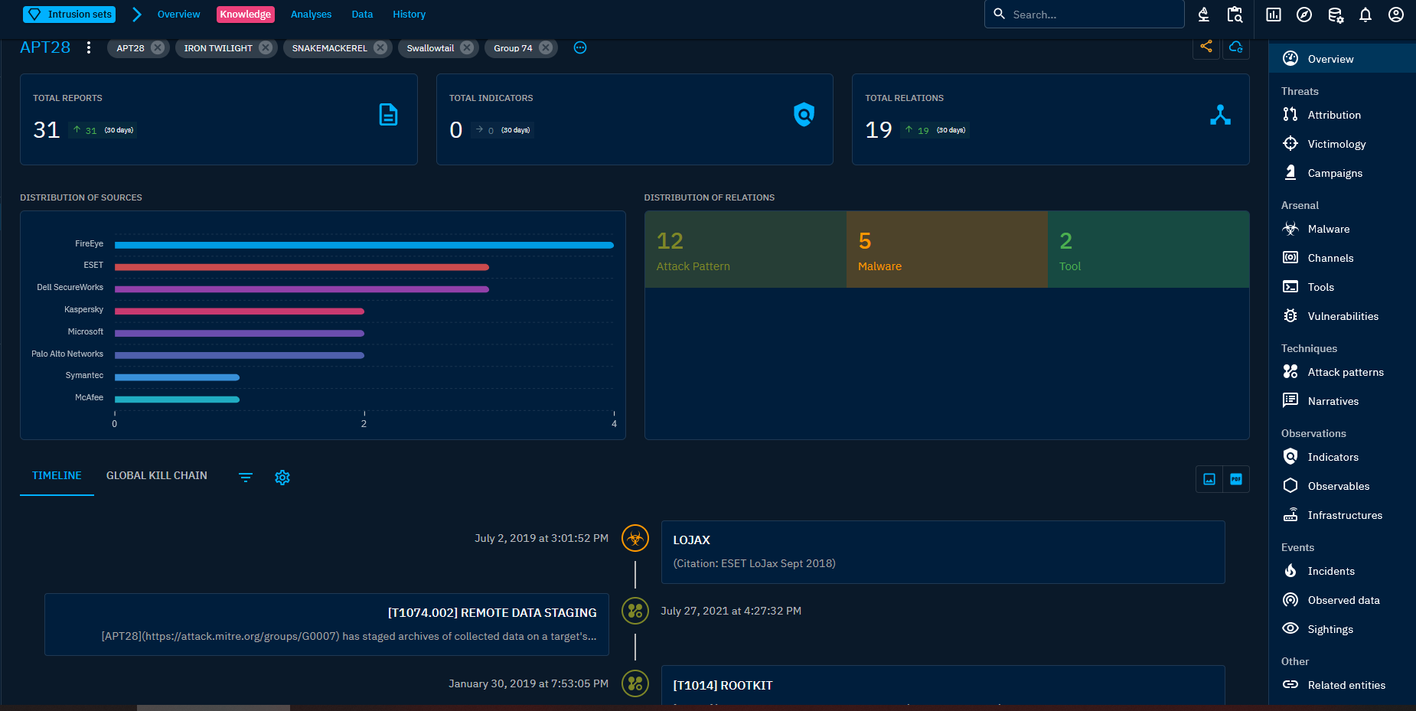
Case Management

Slide 5
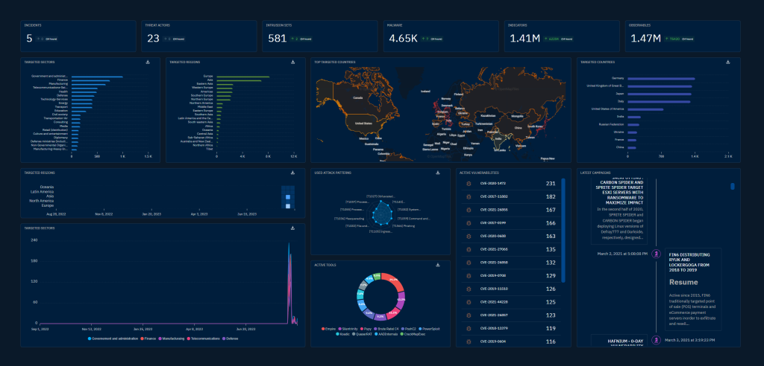
Data Visualization

Slide 6
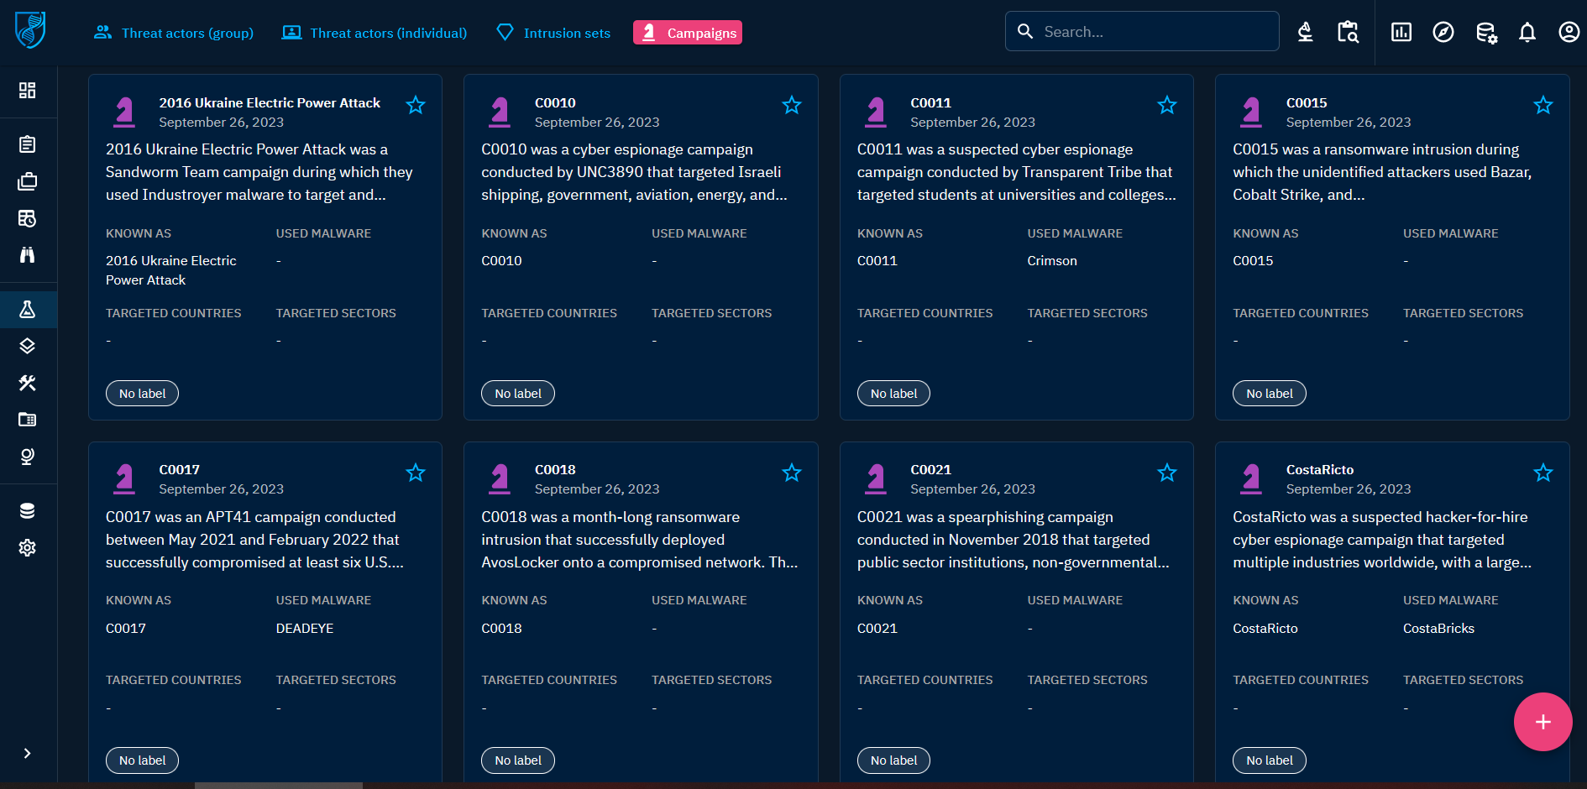
Knowledge Management

Slide 7
Speedrun: Q&A

Slide 8
Q&A: We use MISP
“Malware Information Sharing Platform” is more a “backend” for storing, categorizing and sharing IoCs.
Why not to use both? OpenCTI can ingest MISP events and enrich them with additional threat intelligence (-> see IoCs in TI context).
Your Threat Hunter & Security Analyst can cooperate in OpenCTI while keeping your MISP instance ‘ballast-free’...
https://github.com/OpenCTI-Platform/connectors/blob/master/external-import/misp/README.md
https://www.cosive.com/misp-vs-opencti (no to ‘versus’ approach)

Slide 9
Q&A: We use TheHive/IRIS for Case Mgmt
Depends on your usage scenario, why not to use both?
OpenCTI for your Analysts, potentially better (visualization) for management reporting.
IRIS: https://dfir-iris.org/ (by Airbus Security), gaining popularity after https://thehive-project.org/ license change

Slide 10
Q&A: We use IntelOwl for auto-intel
OpenCTI and IntelOwl complement each other and can work well together
https://intelowl.readthedocs.io/en/latest/Usage.html#connectors
List of pre-built Connectors:
MISP: automatically creates an event on your MISP instance, linking the successful analysis on IntelOwl.
OpenCTI: automatically creates an observable and a linked report on your OpenCTI instance, linking the successful analysis on IntelOwl.
YETI: YETI = Your Everyday Threat Intelligence. find or create observable on YETI, linking the successful analysis on IntelOwl.

Slide 11
Q&A: We use YETI
OpenCTI and YETI are comparable with each having its benefits.
YETI = “…platform meant to organize IOCs and observables”
Why not to use both?
https://yeti-platform.github.io/
Maltego has transforms for both YETI and OpenCTI

Slide 12
Q&A: We use commercial TI provider XY
Ready-made external-import connectors for TI feed providers like
Intel471
Crowdstrike
Eset
Flashpoint
Kaspersky
Recorded Future
Do not ingest TI provider feed into your SIEM directly!!! (unless it’s custom-made for you)
Do not ingest TI provider STIX feed into your MISP directly! (analyze it first in OpenCTI and export to MISP what’s useful)
https://github.com/OpenCTI-Platform/connectors/tree/master/external-import

Slide 13
Q&A: Not easy to deploy/maintain
Can be deployed using Docker together with:
Wazzuh
IntelOwl
MISP
etc.
Instance to generate (some) screenshots for this presentation deployed today on my laptop during morning talks. (Demo?)

Slide 14
Learning / Training / Resources
Medium.com: OpenCTI platform intro
https://demo.opencti.io/dashboard
https://training.filigran.io/
YouTube: Introduction to the OpenCTI platform
TryHackMe.com: OpenCTI room (subscribers only) -> prepared and configured instance, used within guided case investigation

Slide 15
Thank you
Demo?
Try it yourself in Docker!
https://github.com/smidrkal/OpenCTI (License: Unlicense = do as you like)

