Slide 1
Coordinated vulnerability disclosure process in Latvia – chapter II
69th TF-CSIRT meeting
Bucharest, 25 May 2025 – Baiba Kaškina

Slide 2
The Landscape

Slide 3
The Landscape
Coordinated Vulnerability Disclosure = (?) Responsible Vulnerability Disclosure
Players
  Cybersecurity researchers / hackers?
  Product owners, companies
  Cybersecurity community, product users
  CERTs
  Governments/ Law Enforcement
  Underground / black market
Legislation
Cooperation
Bug bounty platforms and programmes

Slide 4

HackerOne

Slide 5
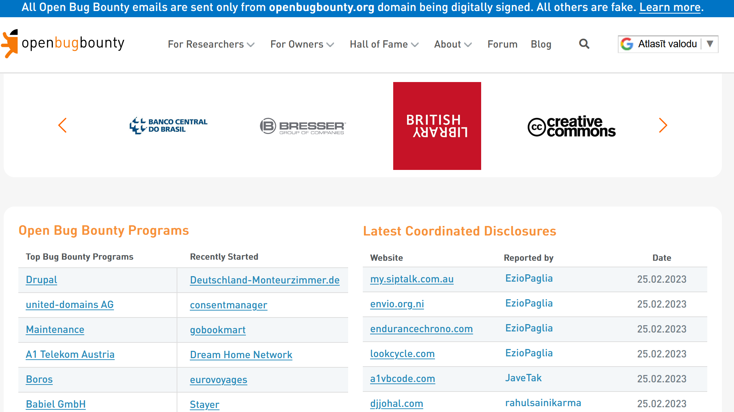
Open Bug Bounty

Slide 6
Looking broader

Slide 7
European approach
NIS2 directive – MS should take measures to facilitate coordinated vulnerability disclosure by establishing a relevant national policy - by 17 October 2024
ENISA publication «Developing National Vulnerabilities Programmes»
https://www.enisa.europa.eu/news/coordinated-vulnerability-disclosure-towards-a-common-eu-approach
https://www.enisa.europa.eu/publications/developing-national-vulnerabilities-programmes

Slide 8
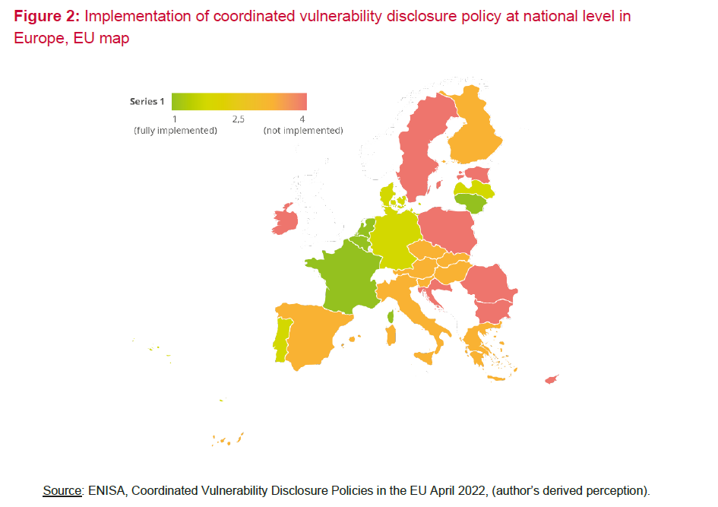
Coordinated Vulnerability Disclosure Policies in the EU

Slide 9
Latvia 2016
The first attempt to put RDP in the law

Slide 10
RDP - 2016
Attempt to change the legislation
The goal – to protect the researcher
Key challenges
  Defining vulnerability and responsible disclosure process
  Changes in the criminal law – if the researcher followed the rules then he/she will not be liable (professional risk)

Slide 11
Problems (1)
  How to define that vulnerability has to be found with minimal damage?
    Impact to confidentiality, integrity and availability
    Minimal set of data to proof the problem
  How to put in the law the communication process? How granular?
    «Thank you» when the report is received
    «Yes/no» when the vulnerability is verified
    90 days process from that day – updates?
    CERT.LV can extend 90 days period?

Slide 12
Problems (2)
  Publishing – what to say/not to say in the law about it?
    Freedom of speech
    If you publish before «the time» you can get prosecuted
  Criminal law – which clauses are related to the professional risk exception?
    What about usage of automated systems?
    To prosecute 4 attributes of a criminal offence have to be present – including malicious, motivated intention

Slide 13
Proposal dropped
Too detailed requirements from the researcher
Too cumbersome process
NO from law enforcement side
  Encouragement to hack
  Problem with anonymity (register of hackers?)

Slide 14
Latvia 2022-2023
The second attempt with the CVD process

Slide 15
The Setup
Different goal – to enable state institutions to participate
To promote CVD
To attract more international talent
No changes in the legislation (Informative report to the Cabinet of Ministers)
CERT.LV – coordinator and implementer

Slide 16
State institutions
Encouraged to participate (by CoM)
SHOULD publish
  Resources available for testing (the programme)
  CVD contact information
  Limitations and specific requirements
MUST fix the problem

Slide 17
Researchers
Invited to participate
MUST follow the rules of the platform and each programme
Receive help from CERT.LV to coordinate the problem
Can report anonymously
Can receive recognition

Slide 18
CERT.LV
The main coordinator of the process
Evaluating the report – TRUE/FALSE
Coordinating with institutions, researchers, third parties
CVEs
Recognition
Providing the platform for collaboration

Slide 19
cvd.cert.lv
Launched March 2023
Participants – 22 (20 organisations)
Registered 20 programmes (only 2 active so far)
  18 need more info before publishing
Security researchers - 28
Vulnerabilities received so far
  4 - about cvd.cert.lv
  5 – regarding other organisations

Slide 20
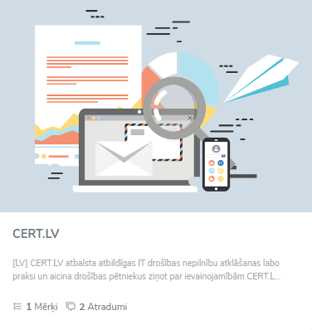
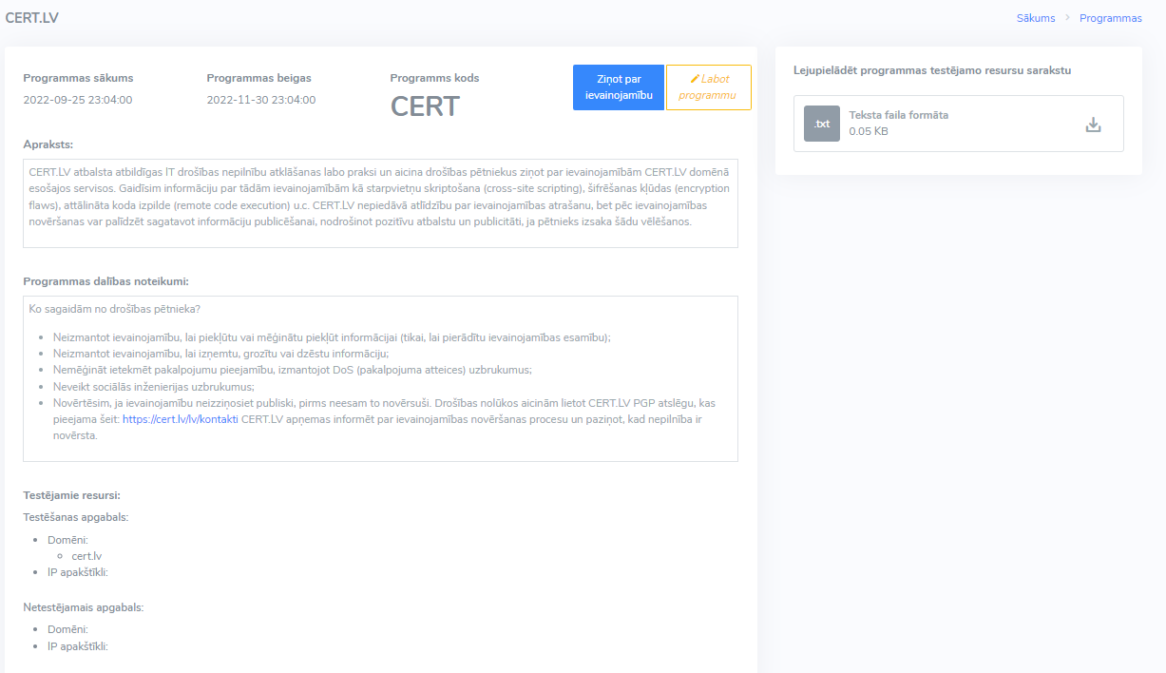
The CVD Platform

Slide 21
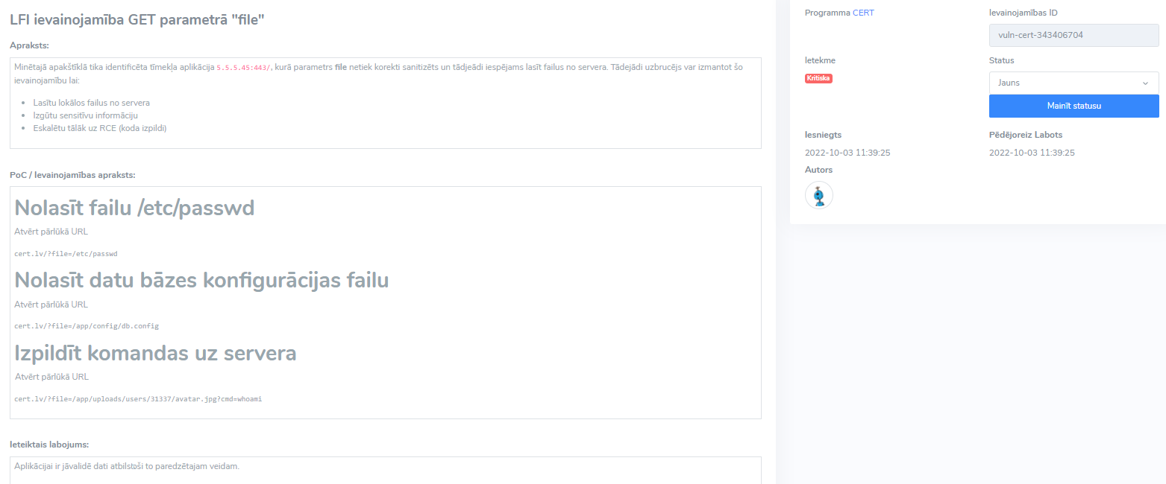
Vulnerability report

Slide 22
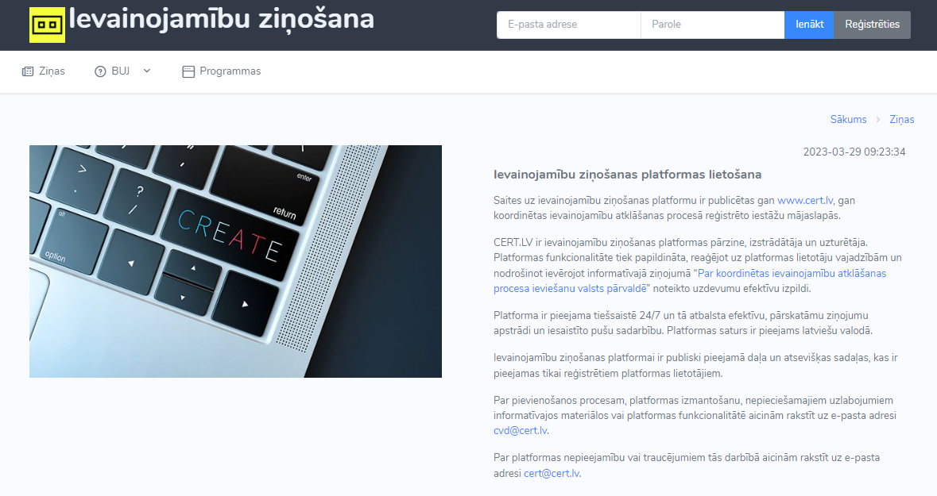
News

Slide 23
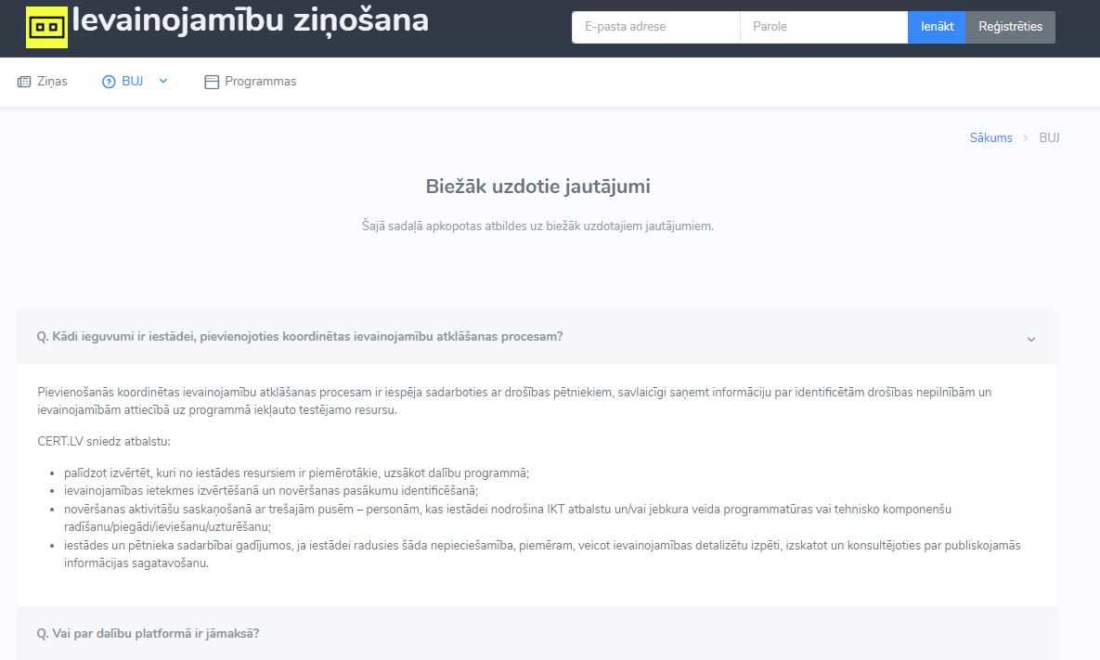
FAQ

Slide 24
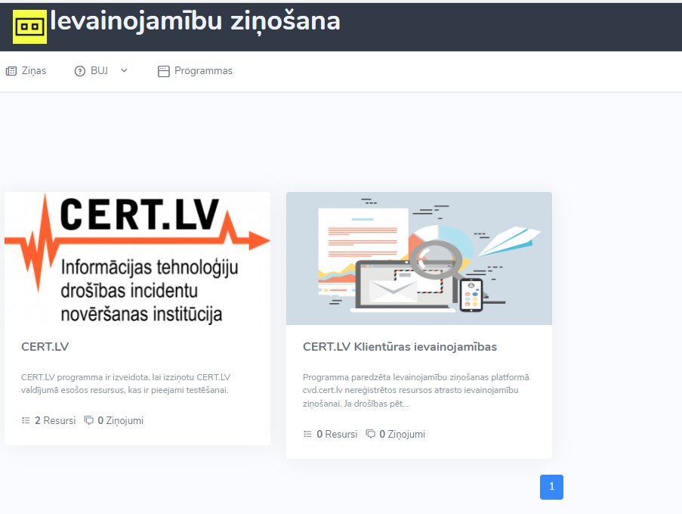
Published programmes

Slide 25
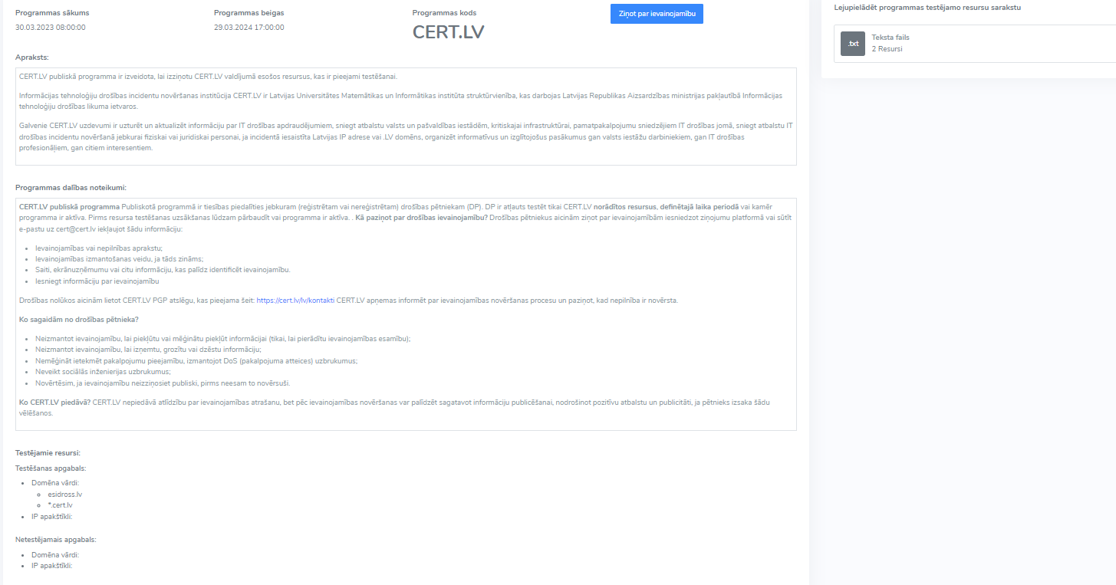
Info about the programme
Notes:
Ievainojamību var ziņot reģistrēts lietotājs

Slide 26
The Status and Issues
Platform development takes time
Next steps
  Design and features
  Promotion
Constituency is not very motivated to register
Researchers are more motivated, but what about the recognition
Who will process the reports @ CERT.LV?
Such project needs a dedicated admin/project manager
The name...

Slide 27

Thank
you!
baiba.kaskina@cert.lv
https://www.cert.lv
certlv
certlv

