Slide 1
Presentation title
Presentation subtitle
Presenter

Slide 2
Steering Committee Updates
Issues with attracting presentations.
TF-CSIRT Futures Consultation Report.
Future Working Group Meeting on Tuesday (all can attend).
Will be circulated to Accredited Teams.
Other interested parties request from Nicole.
Lightweight NDA for Guests to the Closed Meeting.
Hosts for future meetings.
TRANSITS Update:
Legal, Technical and Organisational now published online under Creative Commons.
Template certificate to be provided.
Extending options for Train the Trainer.
Extra TRANSITSII in January 2020 (NL).
CSIRTS in Asia (see next slides).

Slide 3
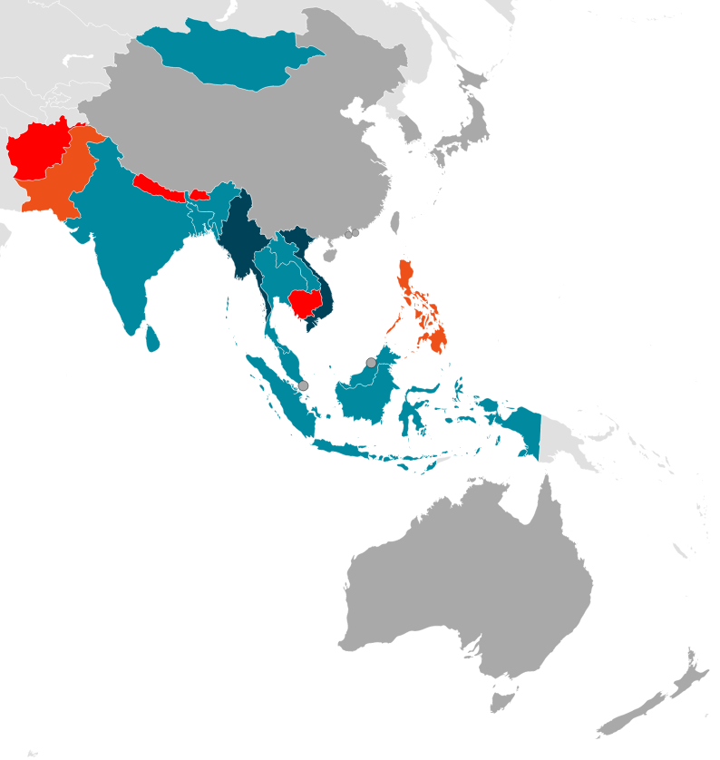
CSIRT Development in Asia
4 TRANSITS I trainings
60+ participants
15 countries

Slide 4
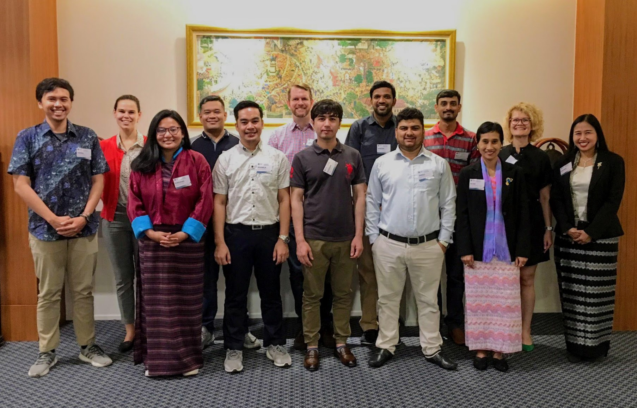
CSIRT Development in Asia - Train the Trainer
Bespoke Train the Trainer course
10 participants
9 countries
Notes:
What is next – the participants will run their courses using TRANSITS materials
Apply for funding, organize more trainings for the R&E security community in Asia Pacific – you can do it too! Run it yourself or invite us, or APNIC trainers
Cybersecurity threats defy national borders, and so should we.

Slide 5
Elections!
Nominations for Chair:
Silvio Oertli, SWITCH-CERT. Nominated by CERT.LV.
Nominations for Steering Committee:
Andre Oosterwijk, KPN-CERT. Nominated by TeliaCERT.
Rossella Mattioli, ENISA. Nominiated by CERT.be.
Rogerio Gil Raposo, CERT.PT. Nominated by SWITCH-CERT.

