Slide 1
Meeting with GEANT management and
TF-CSIRT future
Steering Committee update
Vilnius
26th September 2018

Slide 2
To be covered
TF-CSIRT – past and present
Meeting with GEANT management on 16 July, current issues
TF-CSIRT future
Other items

Slide 3
Past and present

Slide 4
TF-CSIRT, Trusted Introducer and TRANSITS
TF-CSIRT
TRANSITS Training
TF-CSIRT
Steering Committee
Trusted Introducer
GÉANT Task Force but not typical.
Even mix of NREN, commercial, government / national CERTS.
Meets three times a year.
150 – 200 people per meeting.
Closed, only for teams in TI.
Provides both taught courses and licenses materials for general use.
Procured service.
Supports listing, accreditation and certification of teams.

Slide 5
Timeline – TF-CSIRT
1990
The very first CERT in Europe was established by the French Space Physics Analysis Network (SPAN)
1993
RARE CERT Task Force investigated but not implemented.
1995 - 1999
TERENA Security Incident Response Coordination for Europe (SIRCE).
1999
CERT-coord
2000
1st TF-CSIRT meeting.
Trusted Introducer established
https://www.enisa.europa.eu/activities/cert/background/coop/past-present/regional-coop/europe

Slide 6
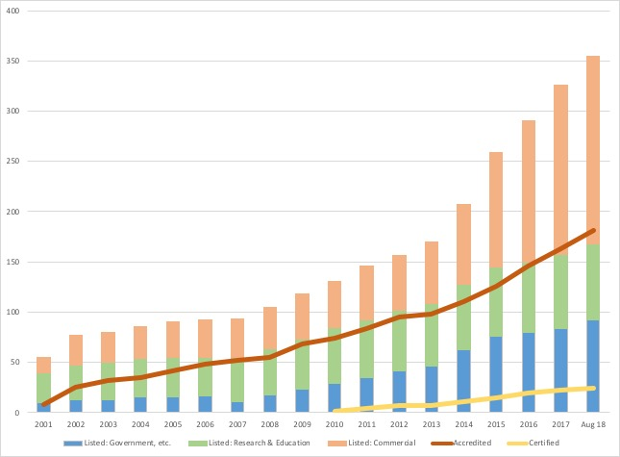
Growth of Teams
As of 31 August 2018: 347 teams 171 listed including 3 candidates 152 accredited including 3 candidates 24 certified

Slide 7
Changes in 2011 (first TI / TF-CSIRT Review)
TF-CSIRT, Trusted Introducer and TRANSITS brought together as a portfolio
Single Steering Committee created. SC given jurisdiction over TI and TRANSITS.
First TI service procurement
TF-CSIRT established as the central “brand”
Acknowledged as beginning of journey away from Task Force

Slide 8
TF-CSIRT @ Riga May 2016
Wide consultation with the community
Decision on what to do with the procurement and future
Results:
SWOT analysis
Strong decision to stay with GEANT for now and go for a new procurement
To look into other options for the future

Slide 9
Strategy meeting @ Meilen – March 2017
TF-CSIRT SC and GEANT, 2 day workshop
TF-CSIRT Strategy development
Facilitated by GEANT
TF-CSIRT strategy formulated including mission, strategic aims, etc.
The mission of TF-CSIRT is to facilitate and improve the collaboration within the European CSIRT community to make cyber space a better place

Slide 10
Strategic Aims
Improve TF-CSIRT governance
Leverage community knowledge
Champion the prestige and visibility of TF-CSIRT
Develop a future business and financial model
Improve face-to-face engagement
Improve internal organizational processes
Safeguard and enhance the trusted infrastructure’s maturity process

Slide 11
Meeting with GEANT management
16 July 2018, Amsterdam

Slide 12
Meeting in Amsterdam
Participants from SC – Baiba, Sven, Shehzad, Nicole, Sigita
GEANT Executives Erik Huizer and Klaas Wierenga
Aim – to discuss:
Existing issues with GEANT
Possible future scenarios

Slide 13
Issues - 1. Resources
Issue - more secretariat resources needed than available.
How it affects us - agreed activities are not moving forward as expected.
Consequences – delays in delivery, less accomplished between the meetings.
What’s needed – more PM for TF-CSIRT activities.

Slide 14
Issues - 2. Responsiveness – procurement, agreement
Issue - slow response – procurement, legal department.
How it affects us:
Change requests are not approved since September 2017.
GDPR is not implemented in the agreement with TI.
Consequences – changes in TI services approved by SC but not implemented.
What’s needed:
More flexibility with the TI agreement.
Faster implementation of change requests.

Slide 15
Issues - 3. Responsiveness – finances & payment
Issue - slow responses - finances & payment [recently this has been improved].
How it affects us – we do not have information on regular basis regarding who has paid for the TI service.
Consequences – outstanding invoices for long periods.
What’s needed – regular information from the finances department on who has paid for the TI service.

Slide 16
Issues - 4. TRANSITS future
The trainings are one of the top activities to position us (and therefore GEANT) as the experts in the field of CSIRT activities.
Issue - GEANT is limited to what can be done regarding TRANSITS, particularly – in-house training, online courses, etc.
How it affects us – TRANSITS courses are limited to 2+1 courses per year.
Consequences – growth in this area is limited. This activity has the risk, if not doing it with the required effort/support, it may even have a negative impact, in case the quality of the training does not reach a certain standard.
What’s needed – more flexibility regarding course format, trainers remuneration, more effort, etc.

Slide 17
TF-CSIRT Future

Slide 18
Some thoughts
TF-CSIRT is very different from all other task forces
Size
Needs
Complexity
GEANT members – small part of TF-CSIRT community
What is the best fit for the community?
How does GEANT sees its role in supporting TF-CSIRT achieving the community goals?

Slide 19
Future options
Solve the problems and stay with GEANT
Hybrid model - GEANT + more outsourcing
Other host organisation
Independent organisation

Slide 20
GEANT’s response
Security area is very important, GEANT wants to be involved and collaborate also in the future
TF-CSIRT has outgrown GEANT
Academic community are small part of TF-CSIRT
GEANT has strict cap on manpower
Strict VAT rules and limitations

Slide 21
Meeting outcomes
1. It was agreed that an alternative host for TF-CSIRT should be found within the timetable of the current Trusted Introducer agreement. (Until summer 2022 max.)
2. It was agreed that an independent study should be launched by the TF-CSIRT Steering Committee to support this work, funded from the TI budget held at GÉANT.

Slide 22
What to do?
To form an Advisory working group
Define the problem
Realistic alternatives
Independent study to look at the alternatives
Governance model
Funding
Resources
Legal
TF-CSIRT community to make decision by voting

Slide 23
What to do?
SC is drafting the WG Charter, will be available shortly.
If you want to actively participate in the working group, please let us know – email Zuzana and Baiba
Notes:
Adding email?

Slide 24
Other Items

Slide 25
Re-listing
Will start in October 2018
Main task – to support teams
Max 5 teams per week
Still 44 teams not fulfilling criteria for re-listing

Slide 26
Certifications
New recertified teams
LiU IRT
NCSC-FI

Slide 27
Meeting attendance
Problem – meetings are oversubscribed
Registering, but not coming
Coming without registering
Cancelling participation last minute
Waiting lists
Overbooking???
Should we publish list of attendees?

Slide 28
Taxonomy working group
Reference Security Incident Taxonomy Working Group
https://tf-csirt.org/groups/
Aim: to enable the CSIRT community in reaching a consensus on a reference taxonomy
Chair- Rossella Mattioli, ENISA
Duration – 2 years

Slide 29
Other things
What it takes to be on the SC? – document will be published soon
Next meetings:
56th TF-CSIRT meeting – 21 – 23 January 2018, Tallinn, Estonia
57th TF-CSIRT meeting – 23 – 23 May 2019 in Luxembourg

Slide 30
Questions

